Slide 1
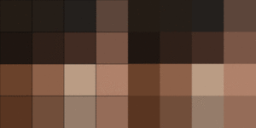
DSA – Project
Image Manipulation using quadtrees
Compression / decompression
Mirroring
Overlapping
Changing Colours
Varun Taneja
111903158
SY Comp – Div2

Slide 2
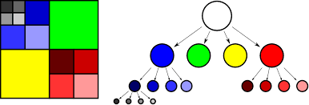
What are Quadtrees?
A quadtree is a tree data structure in which each internal node has exactly four children. Quadtrees are the two-dimensional analog of octrees and are most often used to partition a two-dimensional space by recursively subdividing it into four quadrants or regions. The data associated with a leaf cell varies by application, but the leaf cell represents a "unit of interesting spatial information“.

Slide 3
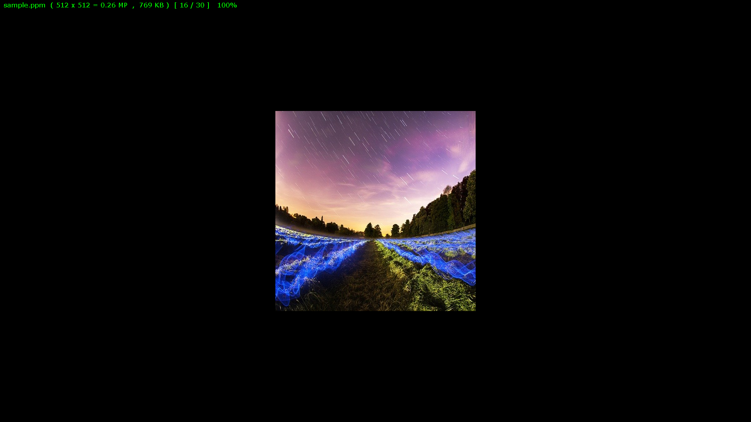
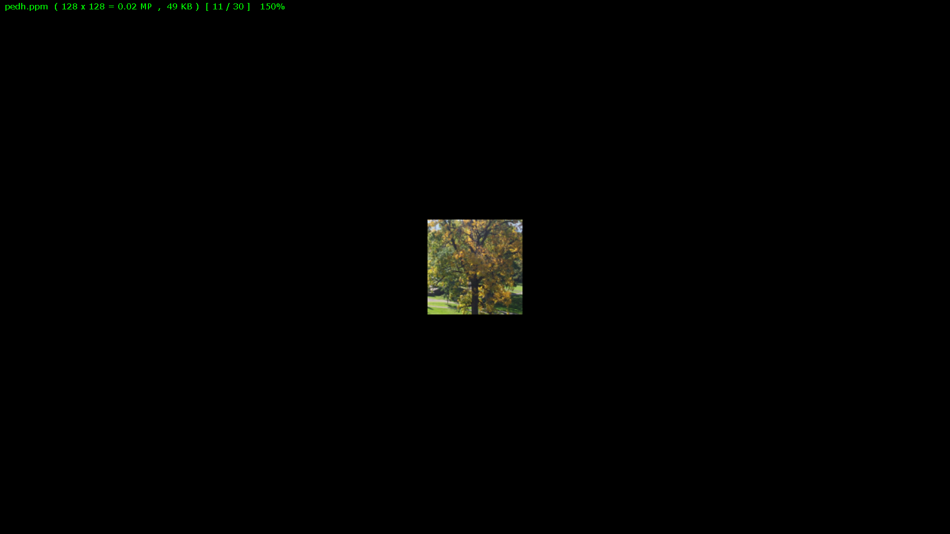
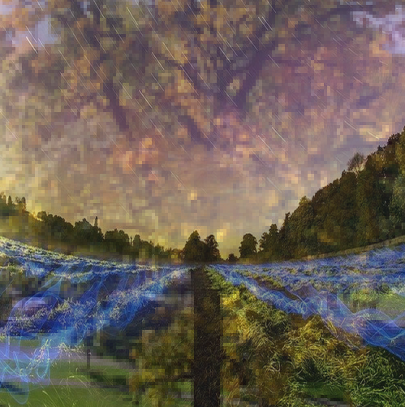
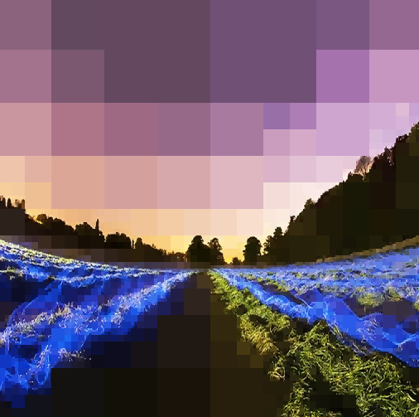


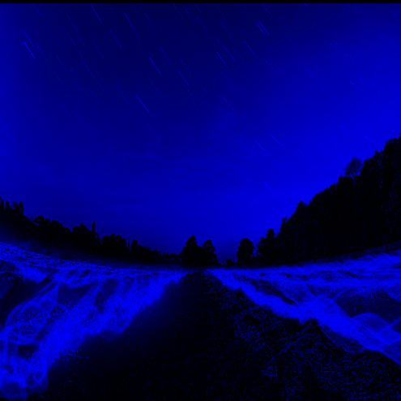
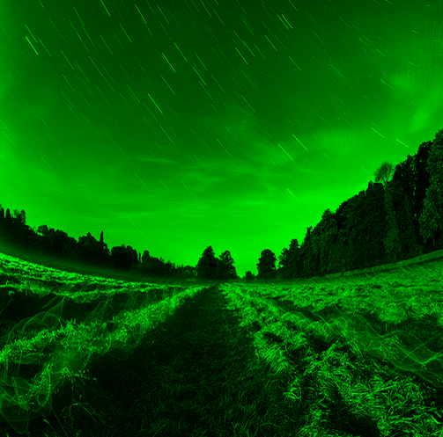
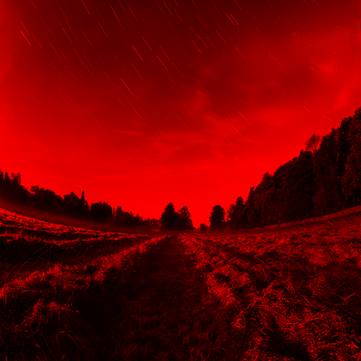
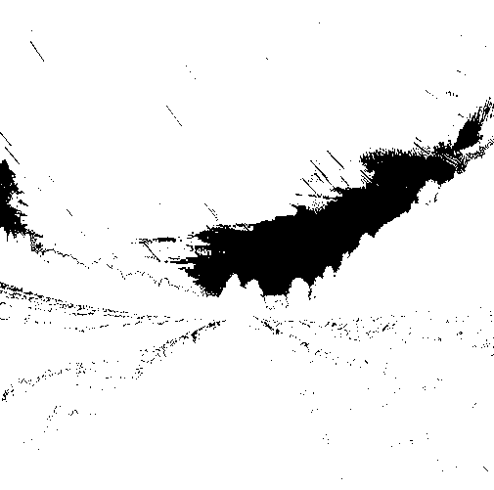
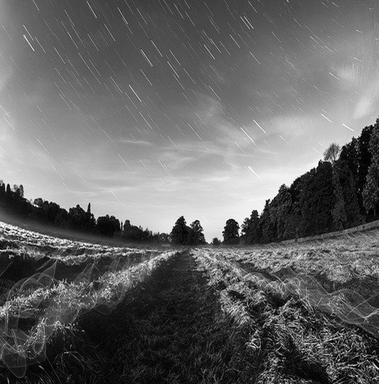
What have I done ?
Compression of Images
Decompression of Images
Horizontal or Vertical flipping of Images
Overlapping two Images
Changing an image into a single colour ie – Red / Green / Blue / greyscale / black&white
Image 1
Image 2
Overlapping Image 1 & 2
The Images used in my program are all in PPM (portable pixmap) format.
Compressed Image
Horizontal Mirroring
Vertical Mirroring
Blue
Green
Red
Black & White
Greyscale

Slide 4
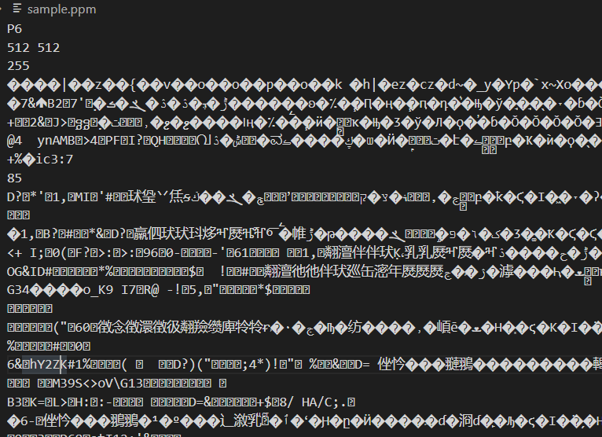
What is a PPM image ?
To view ppm images we have to download FastStone Image Viewer
A PPM file consists of two parts, a header and the image data. The header consists of at least three parts – The first "line" is a magic PPM identifier it can be P6. The next line consists of the width and height of the image as ASCII numbers. The last part of the header gives the maximum value of the colour components for the pixels, this allows the format to describe more than single byte (0 to 255) colour values.

Slide 5
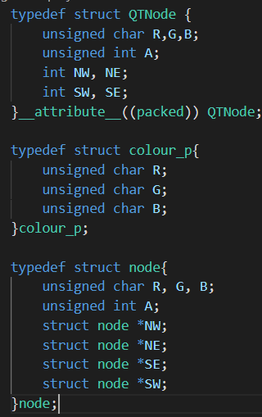
ADTs used -
QTNode – it’s the node of a quadtree which will be stored in a file (in the form of an array)
__attribute__((packed)) -- attached to struct or union type definition, specifies that each member of the structure or union is placed to minimize the memory required.
Colour_p – represents a single pixel of an image
node – it’s the node of a quadtree ie. has pointers to its children therefore used where we want to mention the roots of a tree.

Slide 6
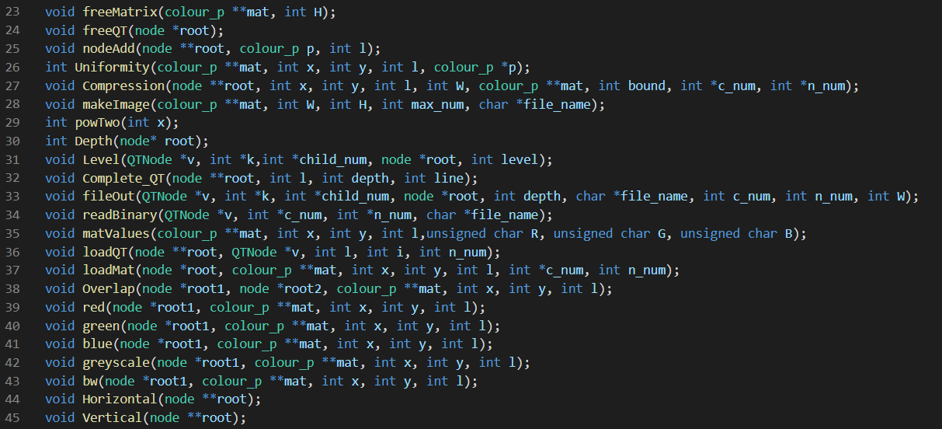
Functions Used -

Slide 7
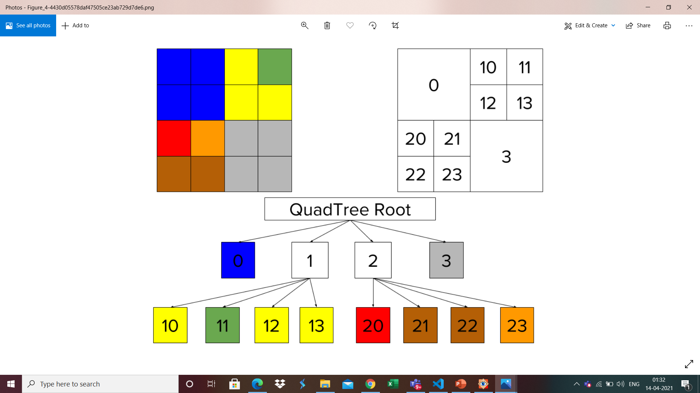
General Idea -
The root of the Quadtree represents a square and the four children of the root correspond to the four squares that making up the whole image and this these 4 squares can then be recursively split into another four children.
Till the time a child node doesn’t have pixels with average colour below the entered boundary, it can’t represent a leaf node and therefore it must be split up into four nodes. We repeat this idea unit all the leaf nodes have pixels with average color that corresponds to the entered boundary.
The average colour of each pixel is calculated using the formula -
In my program I use images which have height and width of powers of 2

Slide 8
How to use?
Building the program - gcc proj.c main.c –o test
Compress - ./test –c bound x.ppm y.out
Decompress - ./test –d y.out z.ppm
Mirroring - ./test –m h or v or n bound x.ppm y.ppm
Overlapping - ./test –o bound x1.ppm x2.ppm y.ppm
Changing colour - ./test –t R or G or B or Bw or Gr bound x.ppm y.ppm
//all in yellow are variables and can be changes
// bound has to be an integer (in general should be more than height and width)
//x , x1 , x2 ,(input files - images) z (binary output file) and y(output file – image) are file names
//In mirroring – h = horizonatl , v – vertical , and n = none
// In changing colour – R = red , G = green , B = blue , Gr = greyscale , Bw = black & white

